Slide 1
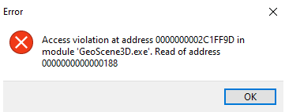
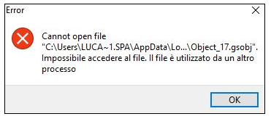
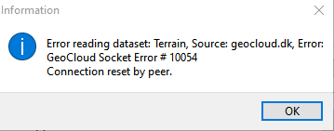
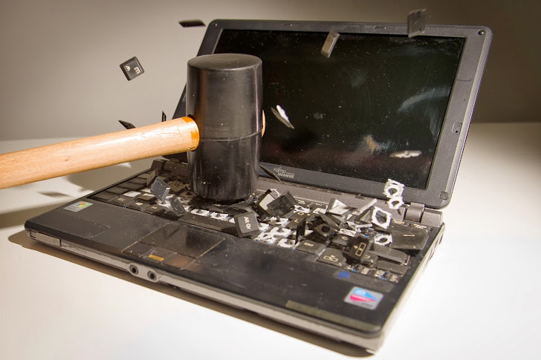
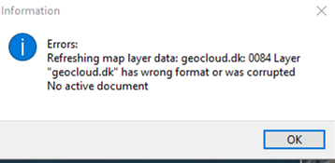
Software Madness
Software madness refers to a state of extreme frustration, confusion, or chaos caused by issues or problems related to software development, deployment, or usage. It often occurs when there are numerous bugs, compatibility issues, or unexpected errors in software systems that hinder their proper functioning. Software madness can manifest in various ways…
By I•GIS
Notes:
Egen præsentation: Tom Pallesen, geolog, har været hos IGIS i 11 år.
IGIS har eksisteret i +20 år. GeoScene3D i +15 år.

Slide 2


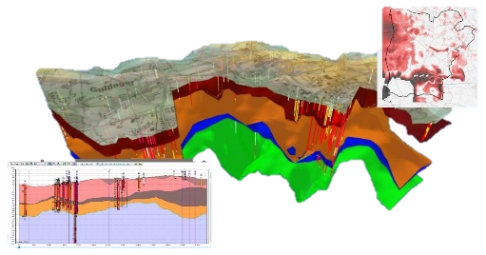
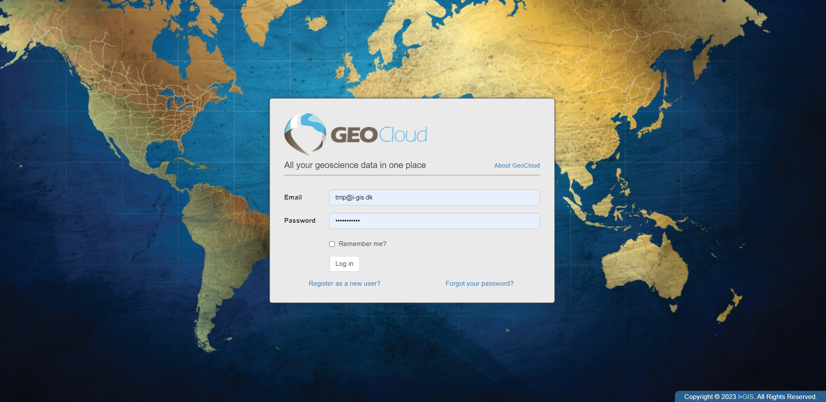
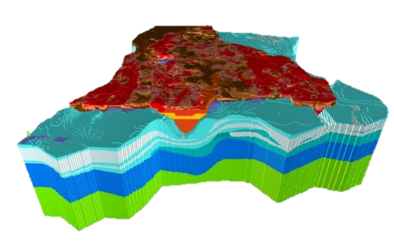
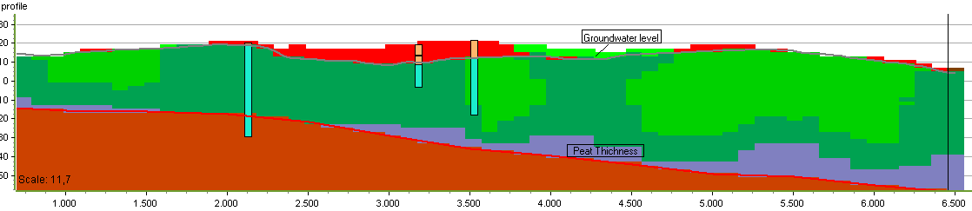
IGIS’ Software Madness
Building models…
…sharing data and models
Notes:
Egen præsentation: Tom Pallesen, geolog, har været hos IGIS i 11 år.
IGIS har eksisteret i +20 år. GeoScene3D i +15 år.
IGIS stabil partner. R&D som munder ud i reelle produkter som kommer alle vores brugere til gode.

Slide 3





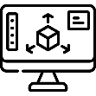
IGIS’ Software Madness
Geological Modelling
Data Hosting
Data Admin
Access/Sharing
LARCOS
WEB Viewer
Desktop software
Add-ons (modules and extensions
Fast user support
Layer models
Voxel Models
Urban models with infrastructure
Strong handling of geophysical data
GIS component
Cross sections
3D viewer
Data integration
Geostatistics
Machinelearning
Common file formats
Cloud storage
Backup systems
Data Security
Support
Data Upload/download
User admin
Data Grouping
Meta data
Web Portal Interface
GIS WMS Services
Directly from GeoScene3D
Large Model admin
Several modelers
Grid update service
3D Model API
Check in/out and QC
3D models in web-browser
Visualization tools incl 3D
Profile view
Synced with GIS map
Large Point Clouds

